Slide 1

Credit
Presented By:
Archit Bansal
Piyush Rajrishi

Slide 2
Index:
Business Overview
Data Imbalance
Categorical Variable Analysis
Contract Type Analysis-------------------------------- Cash Loans vs Revolving Loans
Income Type Analysis---------------------------------- Based on Income Type like: Working etc
Housing Type Analysis--------------------------------- Based on type of housing like: rented, owned, etc
Family Status Analysis-------------------------------- Based on family type like: single, married, etc
Education Type Analysis------------------------------ Based on type of education
Income Range Analysis ------------------------------- Based on range of income
Age Group Analysis ------------------------------------ Based on age group range
Numerical Variable Analysis
Amount Income Mean Analysis
Income vs Credit Analysis
Credit vs Goods Price Analysis
Top 10 correlation of numerical columns
Conclusion

Slide 3
Business Overview
Due to insufficient or non existent credit history of customer, loan company finds difficult in lending the loans.
Insufficient info with company is becoming the advantage for the consumers as they are becoming the defaulter.
Loan company wants to leverage the power of EDA to find patterns in data to identify the potential customers and segregate it from defaulters and non defaulters and help in growing the business of the company.
When customers applies for loan, 4 types of decision can be taken by the company i.e. -
Approved : Company approves application
Cancelled : Customer changed his decision of taking loan, hence cancelled during approval.
Refused : Company refused loan as certain pre-requirements are not met.
Unused offer : Loan has been cancelled by client on different stage of process.

Slide 4
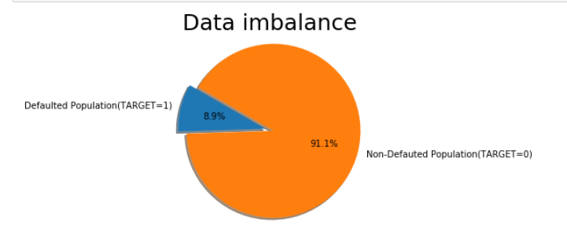
Data Imbalance
Imbalanced data typically refers to an unequal distribution of classes within a dataset. For example, in our application_data dataset, most of the population are found non-defaulted and a very few no. of cases in population are found defaulted. This leaves us with something like 91:9 ratio between the non-defaulted and defaulted population.
Defaulted population = application_data[application_data.TARGET == 1]['TARGET'].count()
Non-Defaulted Population = application_data[application_data.TARGET == 0]['TARGET'].count()
From the visualization, we can see application data has high imbalance.
Ratio = Defaulted Population
Non-Defaulted Population
= 10.23 (approx.)

Slide 5
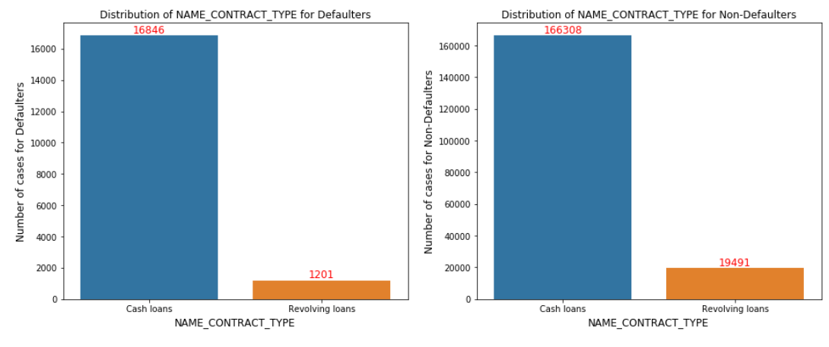
Contract Type Analysis
We can infer from above :
Cash Loans are popular among population.
Revolving loans are comparatively safer.

Slide 6
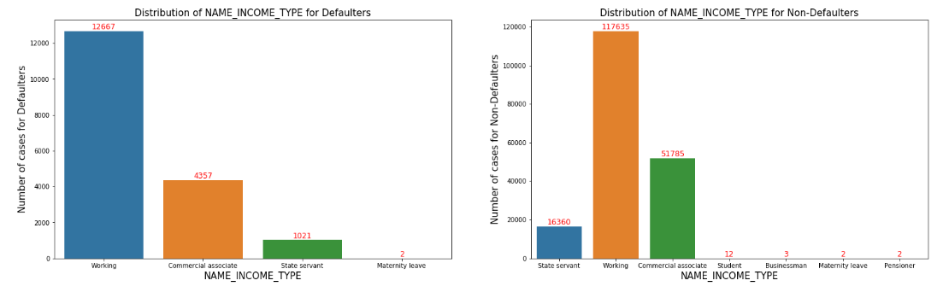
Income Type Analysis
We can infer from above:
Working population are more prone to default.
Commercial associate and state servant are less defaulters.

Slide 7
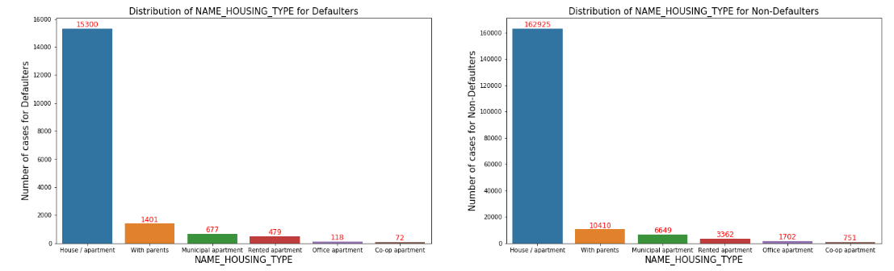
Housing Type Analysis
We can infer from above:
% of People who have their own House/apartment getting defaulted are high for both distribution
Population living in Rented apartments and those living with parents have higher default rate as they have higher proportion in Defaulted population as compared to non defaulted population.
Living in rental apartment means a cash outflow towards rent and thus less cash left for repayment of loan.
Living with parents may suggest that the income is not too high and thus difficulty in repayment of loan.

Slide 8
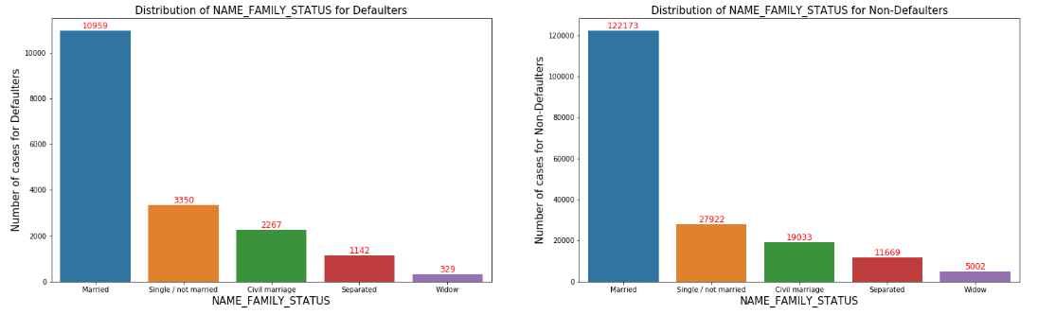
Family Status Analysis
We can infer from above:
Single/ not married is proportionally higher in defaulted population as compared to non defaulted population. This shows that single applicants have higher defaults.
Most of the people taking loans are married individuals & they are most people having difficulties in payments.
Widow individuals, looks like are least interested in taking loans.

Slide 9
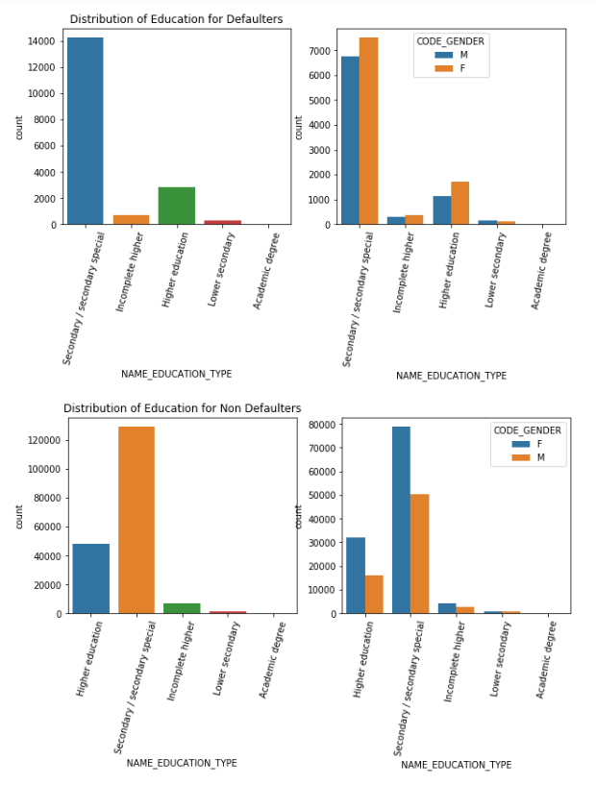
Education Type Analysis
We can infer from the graph:
Most of the people in population have studied up to secondary/secondary special.
It is very well evident that female are in better numbers in terms of receiving secondary/special & higher education.
Females which have incomplete education are in higher numbers.
Females who have not done good in lower secondary education but have done good in higher education demonstrates their fighting ability.
Very few people, almost negligible population have studied or holds a Academic degree which is really weird.

Slide 10
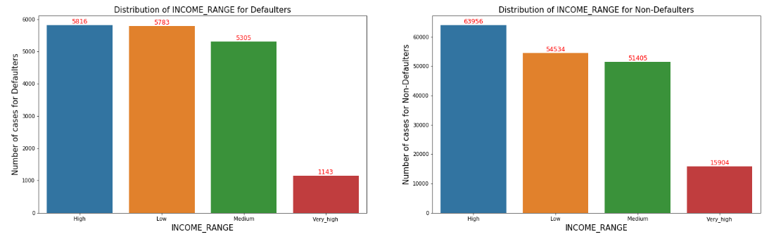
Income Range Analysis
We can infer from above:
Low income range has higher defaults then that of very high income high income range.
As the data is imbalance we can observe that large population is in non defaulted category.

Slide 11
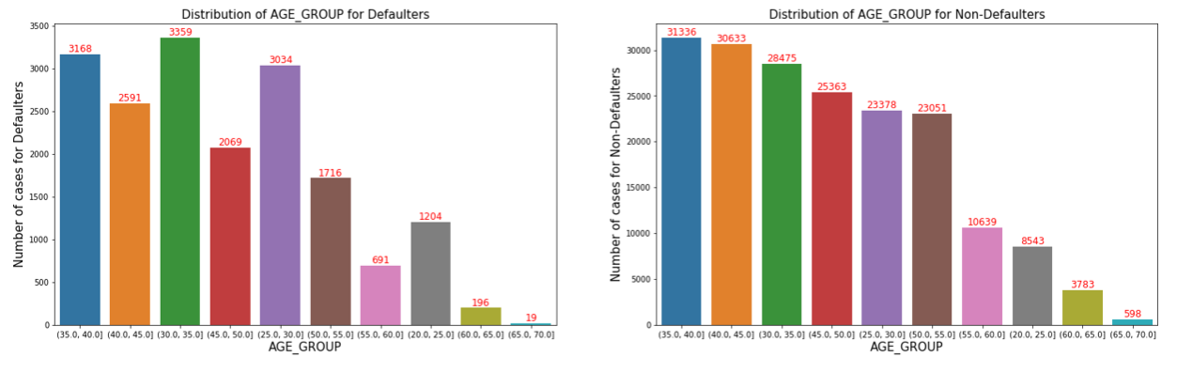
Age Group Analysis
We can infer from above:
People in range from 25 to 40 are prone to default.

Slide 12
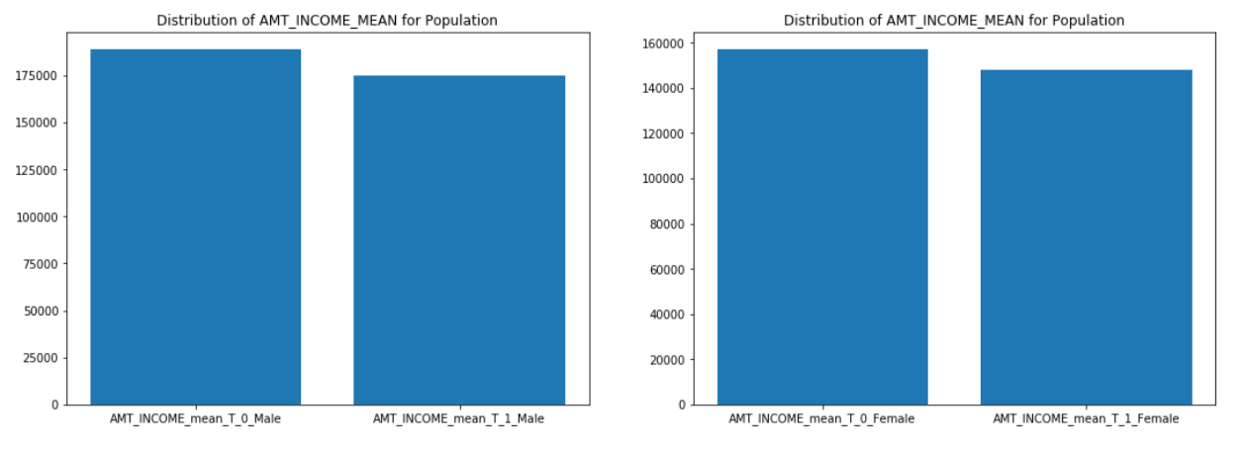
Amount Income Mean Analysis
We can infer from above:
Mean among male defaulters do have less income compared to non-defaulters.

Slide 13
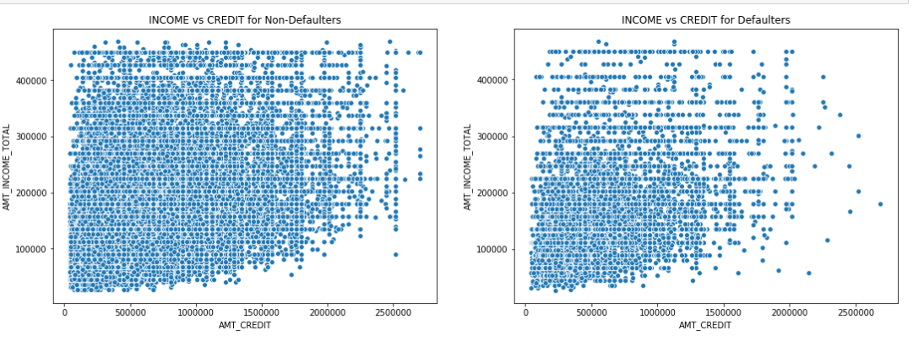
Income vs Credit Analysis
We can infer from above:
Lower number of defaults where income is higher than 300k.

Slide 14
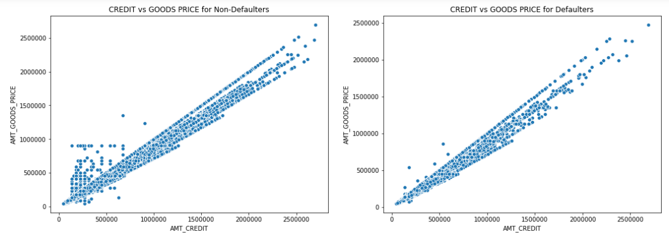
Credit vs Goods_Price Analysis
We can infer from above:
Defaulters are less if price of good is upto 500k and amount credit is also less than 500k.

Slide 15
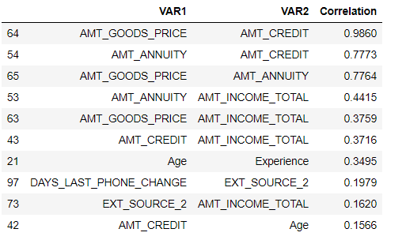
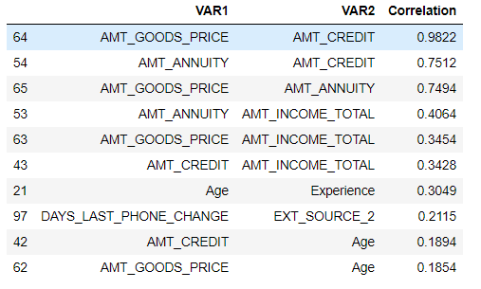
Top 10 correlation for numerical columns
Correlation of data frame Target_0
Correlation of data frame Target_1
We can infer from above:
Almost all the variables for both the correlation in data frame Target_0 & Target_1 is same.

Slide 16
Conclusion
Cash Loans are popular among population.
We can infer from above that revolving loans are comparatively safer.
Working population are more prone to default. 4. Population living in Rented apartments and those living with parents have higher default rate as they have higher proportion in the Defaulted population as compared to non defaulted population.
Single/ not married is proportionally higher in defaulted population as compared to non defaulted population. This shows that single applicants have higher defaults.
Secondary/secondary special are more prone to default.
Low income range has higher defaults as their proportion in defaulted population is higher than in the non defaulted population
25-45 Age group are more prone to default.
Lower number of defaults where income is higher than 300k
Defaulters are less if price of good is up to 500k and amount credit is also less than 500k

Slide 17


